Slide 1
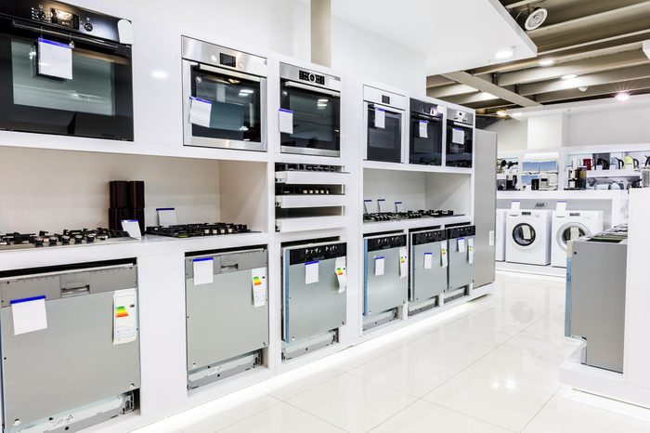

APPLIANCE RETAIL STUDY CASE
Débora Santos - 20200748 Pedro Medeiros - 20200742 Rebeca Pinheiro - 20201096

Slide 2
BACKGROUND
BUSINESS GOAL
Understand each Point-of-Sale characteristics (top products sold, market share preference)
Points of sales clustering divided by value and product preference
Units’ products forecast 6 weeks: one split by product and by point of sale and another one total by-product

Slide 3
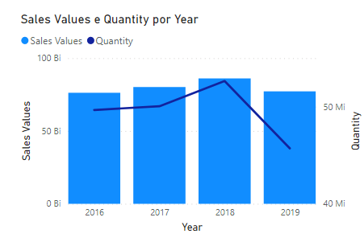
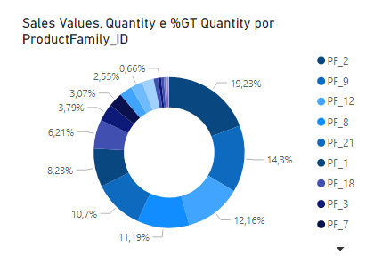
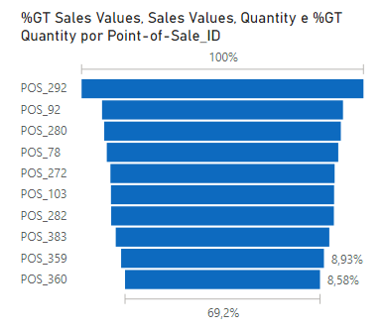
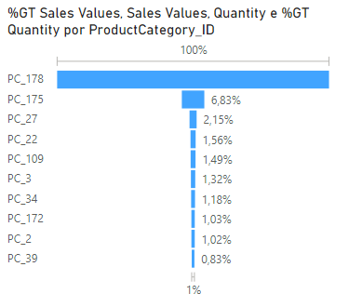
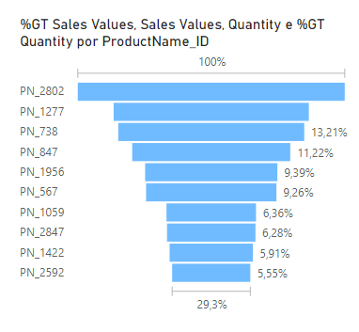
KEY FINDINGS
The year with highest sale were 2018 with more then 86B in sales and quantity more than 52B.
Product family with higher percentage in sales is product family 2 (19% in grand total which correspond to 61B in sales)
The most representative POS in sales is 292, which correspond to 12% of grand total ( more than 2B in sales)
The most representative product category is 178 (239B in sales – 82% in grand total )
The most representative ProductName_ID is 2802 with more than 19B on sales (18,96% in GT)

Slide 4
PROJECT PLAN
Data Preparation:
Eliminate ProductFamily_ID, ProductBrand_ID and ProductCategory_ID columns.
Remove sales which price were below 0
Sales records with 50% discount were excluded.
Feature Engineering:
Create columns Quantity and Sales values from the column Measures.
Create column average price by dividing Sales Values per Quantity.
Create column Perc_Variation from Avg price divided per Mean_Avg_Price.
Modelling:
Clustering
K-means algorithm.
Clusters based on values.
Three clusters defined.
Forecast Demand
LightGBM regressor algorithm
Evaluation:
Clustering
R2
Forecast Demand
R2 and RMSE

Slide 5
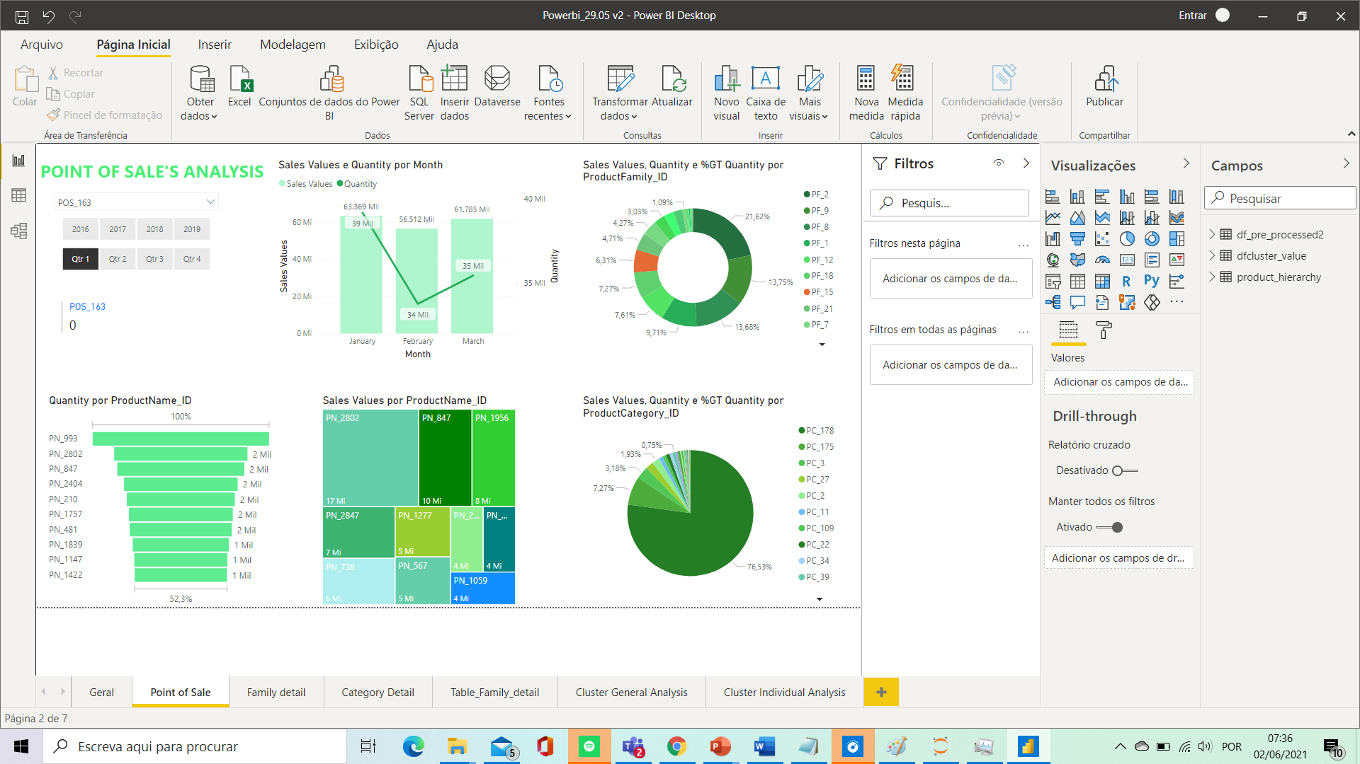
POINT OF SALES ANALYSIS
Todos os graficos estao vinculados ao POS filtrado a esquerda. Como querem fazer?

Slide 6
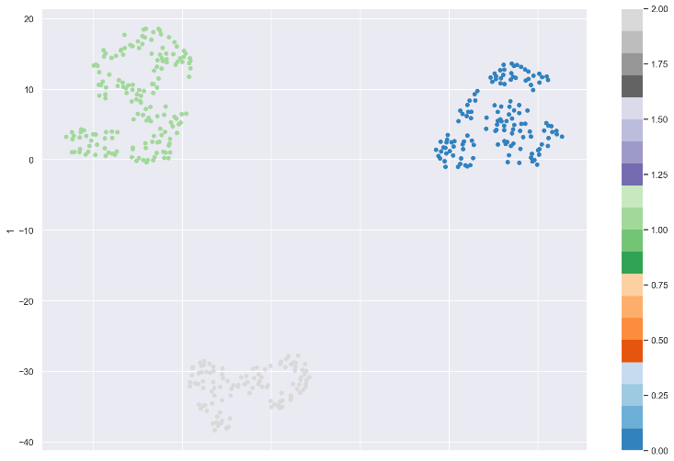
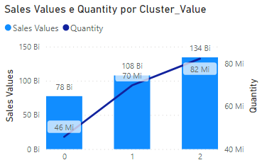
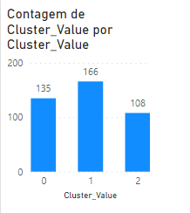
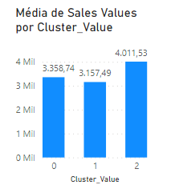
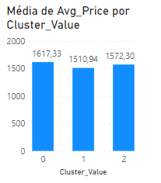
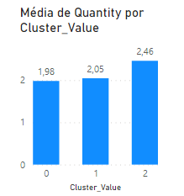
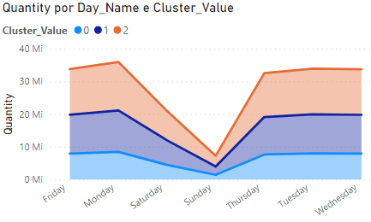
CLUSTER ANALYSIS
The cluster more representative in sales and quantity is cluster 2
Cluster0: 135 POS
Cluster1: 166 POS
Cluster2: 108 POS
The cluster with higher avarage sales is Cluster 2 followed by Cluster 0
Highest avarage price can be found in Cluster 0
The highest avarage quantity can be found in Cluster 2
During the weekend the sales decrease and on sundays is usually the day with less sales.

Slide 7
FORECAST DEMAND

Slide 8
KEY TAKEAWAY
Results:
The sales presents variations between months in sales volume but in values continues aligned.
Quartiles 1 and 4 present highest sales volume.
Cluster: Detected 3 main segments.
Valuable segment: Stores with higher sales values and average price between Bulk and Premium.
Bulk: Stores which average sales volume of products with lowest price
Premium: Stores with products more expensive.
Forecast Demand:
Next Step:
Suggestions:

